Slide 1
Wi-Fi based Indoor Localisation using Machine Learning
Team: 2021415
Prerna Anand
Deeksha Tewari
Hiranya Maharaja
John Adrian Ambrad
Notes:
Good evening everyone. My team and I are going to to go over our project

Slide 2
Motivation

Slide 3
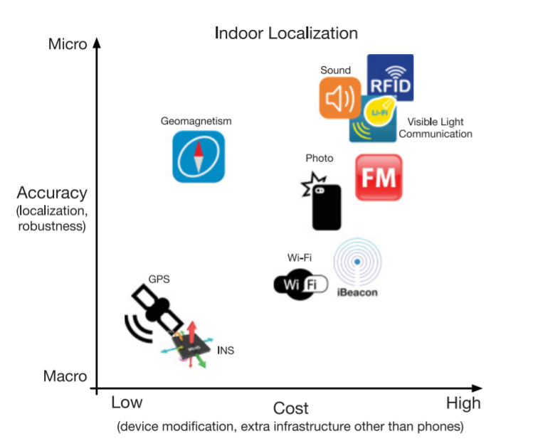
Application of indoor localisation
Helping firefighters conduct search and rescue in an emergency
Customising discounts based on the location of a customer
Allowing indoor robot assistants to map their surroundings better
Fig 1: Graph illustrating the cost vs accuracy effectiveness of various solutions [1]
Notes:
Indoor localisation systems are used to locate a person or object within a building or other enclosed spaces.
The systems’ uses range from helping firefighters conduct search and rescue in an emergency, to customising discounts based on the location of a customer and to allowing indoor robot assistants to map their surroundings better.
Presently, the problem of indoor localization has not been solved in a cost effective way with high accuracy as indicated in the graph. A variety of solutions have been explored which utilize both hardware and software that are either too costly or do not provide granularity (i.e., accuracy) of location. This leads to the need for a system that is easily deployable, accurate, and cost-effective.
The proposed solution is to leverage machine learning techniques in order to predict a target’s location using its received WiFi signal strength (RSS), which would eliminate the hardware costs and make it easy to deploy.

Slide 4
Background
Notes:
Deeksha

Slide 5
Motivation for Wi-Fi Based Solutions:
Ubiquity of Wi-Fi in outdoor and indoor spaces
Low cost of implementation
Motivation for Machine Learning Model:
Using RSSI Wi-Fi Signal strength to predict device location
Provides speed vs accuracy trade offs for Raytracer software.
However, current models are inaccurate and expensive to implement.

Slide 6
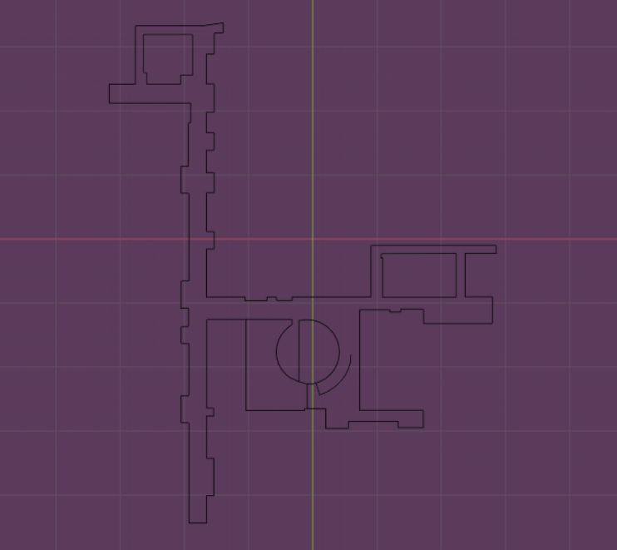
Project Overview
Project Goal: Predict the location of a static object indoors, given its received Wi-Fi signal strength
Project Requirements
Use the RayTracer to collect data from Bahen’s 8th floor
Ensure the model stays within an error of 4 metres
Fig 2: Bahen.stl file used to generate data points with the RayTracer
Notes:
Hiranya
Add Bahen stl or Bahen map, reason we limit ourselves to the 8th floor

Slide 7
System Overview
Notes:
John

Slide 8
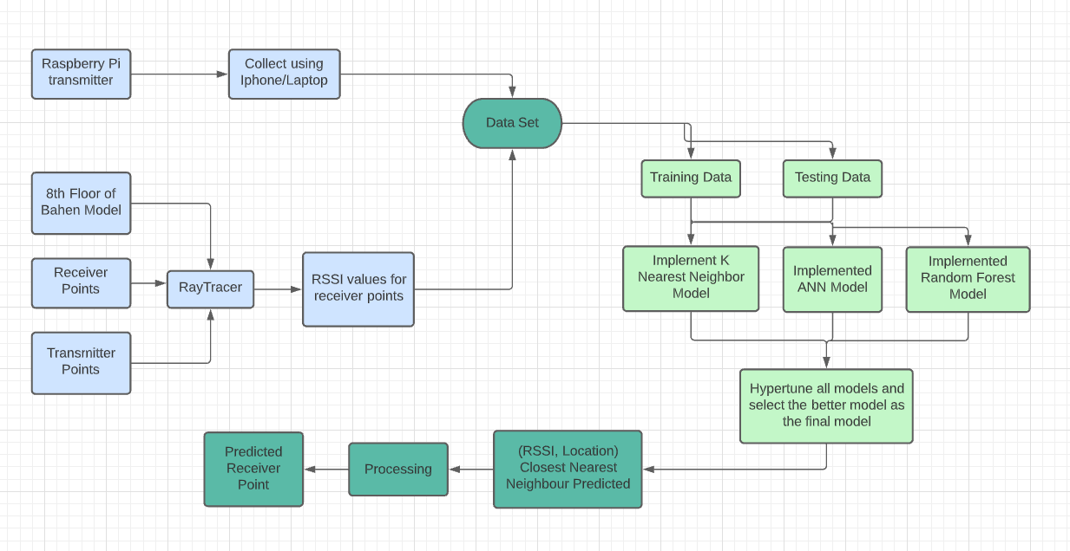
System Overview
Notes:
Simulated data accounts for nearly 100% of our data
Due to COVID19 and school work not able to get Raspberry pi data
Both NN models have been fed the data

Slide 9
Technical Design and Verifications

Slide 10
Technical Design
Verifications
K Nearest Neighbor
Random Forest
Artificial Neural Network
Error checking for each of the models using absolute error method or mean square error method
Notes:
Based on research we decided to work with three models K Nearest Neighbors, Random Forest and ANN.
The random forest was not included as part of our initial plan and has been added to the project after the progress report
The goal of our model is to secure a result error less than 4m. We verified the results of each of these models by calculating the mean absolute error between the predicted and actual result.

Slide 11
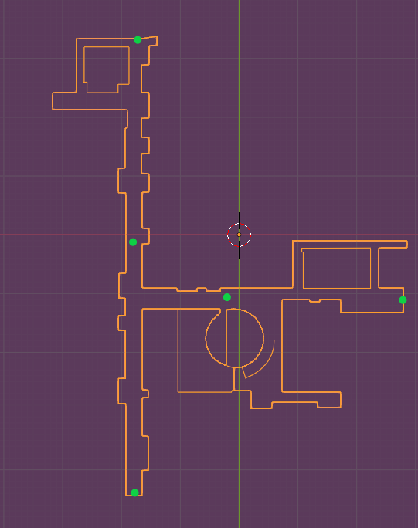
K Nearest Neighbor Model
Implemented the scikit library’s KNN model for proof of concept
Implemented custom KNN model and 2 prediction algorithms.
Mean Absolute Error ([Predicted x, Predicted y], [Actual x, Actual y])
Fig 3: Bahen stl map with access points marked in green
Notes:
The first model we implemented was the K Nearest Neighbor Model which is a unsupervised model. A unsupervised model learns only the data points and not the result and tries to find a correlation between the data points.
KNN model predicts the k closest neighbors to the test point. Based on the labels of the k closest points, we implemented a few prediction models to find the most accurate result.
We started of with scikit libraries’ KNN for proof of concept, and then moved on to on creating a custom KNN.

Slide 12
Prediction
Average based
Exponential weight based
Predicted x = average of all x values
Predicted y = average of all y values
Received a prediction with 4.99 m error using 3 access points
Received a prediction with 4.18 m error using 5 access points
Predicted x = [ x0 + x1*(1-a) + ... + x9*(1-a)^9 ] / [ 1 + (1-a) + … + (1-a)^9 ]
Predicted y = [ y0 + y1*(1-a) + ... + y9*(1-a)^9 ] / [ 1 + (1-a) + … + (1-a)^9 ]
Received a prediction with 4.09 m error using 5 access points
Notes:
For the prediction algorithm, we have implemented an averaging model and an exponential weight based model.
The averaging model finds the total average error. It predicted an error of 4.99m with 3 access points.
To further reduce the error, we simulated data for two more access points to triangulate the location better. Increasing the number of access points has been favorable. The averaging model’s error was reduced to 4.18m.
Then, we moved on to create the exponential weight based model to further reduced the error. It predicted with an error of 4.09m which is just 0.9m higher than our target.
Next, Deeksha will go over the other models

Slide 13
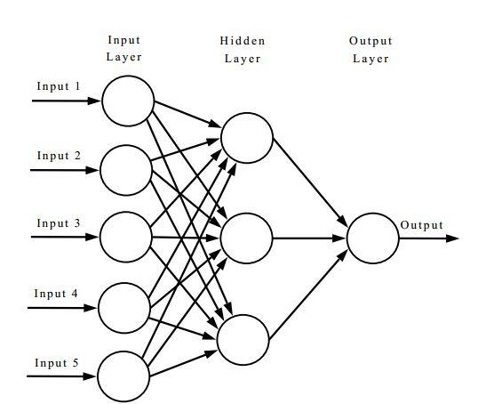
Artificial Neural Network
Structure:
Hidden Layers: 2 (1st layer: 150 nodes, 2nd layer: 10 nodes)
Input N: {RSSI_source1; RSSI_source2; RSSI_source3, RSSI_source4, RSSI_source5}
Output layer: {x,y} receiver location
Model Evaluation:
No of iters done: 146.00
Mean Absolute Error: 5.13
Mean Squared Error: 51.51
Root Mean Squared Error: 7.113
Mean Absolute Percentage Error: 0.85
Figure 4: Sample ANN Structure [2]
Notes:
Deeksha

Slide 14
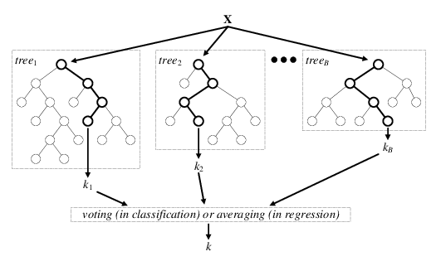
Random Forest Regressor
Used a depth of 100 per decision tree with 2000 trees in total
Random forest regression achieved an error of 2.77m
Utilized scikit learn to implement the random forest
Fig 5: Random Forest [3]

Slide 15
Prediction
Predicted x = Raw Output of model
Predicted y = Raw Output of model
Received a prediction with 4.72 m error using 3 access points
Received a prediction with 2.77 m error using 5 access points

Slide 16
Progress Update
K Nearest Neighbors | Artificial Neural Network | Random Forest
Final KNN model has a mean absolute error of 4.09 m | Final ANN model has a mean absolute error of 5.13 m | Final Random forest model has a mean absolute error of 2.77 m
The random forest has been selected as the final model for this project

Slide 17
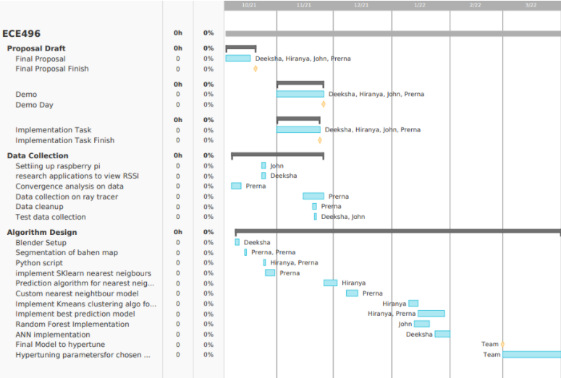
Progress Update
Notes:
Add gantt chart

Slide 18
Conclusion
Promising results have been shown
Selected the final model. Will hypertune it to further reduce the error
Notes:
John

Slide 19
References
[1] Roy, P., Chowdhury, C. A Survey of Machine Learning Techniques for Indoor Localization and Navigation Systems. J Intell Robot Syst 101, 63 (2021). https://doi.org/10.1007/s10846-021-01327-z
[2] DattaChaudhuri, Tamal & Ghosh, Indranil. (2015). Forecasting Volatility in Indian Stock Market using Artificial Neural Network with Multiple Inputs and Outputs. International Journal of Computer Applications. 120. 7-15. 10.5120/21245-4034. https://www.researchgate.net/figure/A-simple-ANN-model_fig1_278729439
[3] A. Verikas, E. Vaiciukynas, A. Gelzinis, J. Parker and M. Olsson, "Electromyographic Patterns during Golf Swing: Activation Sequence Profiling and Prediction of Shot Effectiveness", Sensors, vol. 16, no. 4, p. 592, 2016. Available: 10.3390/s16040592.

